Slide 1
Chapter 12
Point-to-Point
Access:
PPP

Slide 2
12.1 Point-To-Point Protocol
Frame Format
Transition States

Slide 3
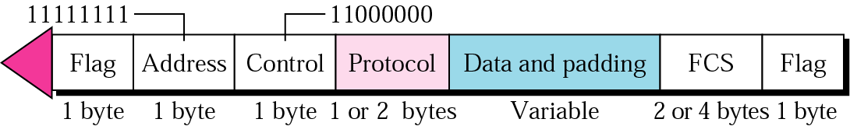
12.1 PPP frame

Slide 4
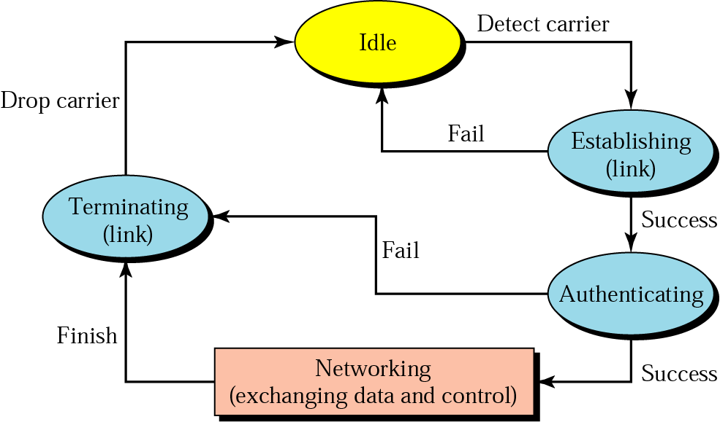
12.2 Transition states

Slide 5
12.2 PPP Stack
Link Control Protocol (LCP)
Authentication Protocols
Network Control Protocol (NCP)
Bit Padding
Digital Signals (DS) Services

Slide 6
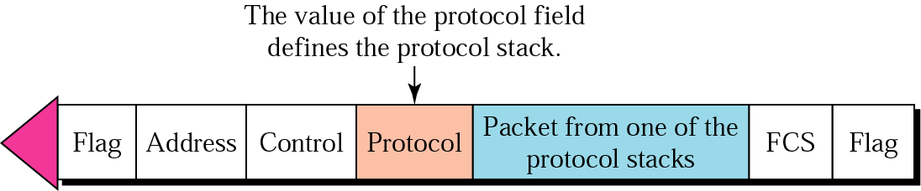
12.3 Protocol stack

Slide 7
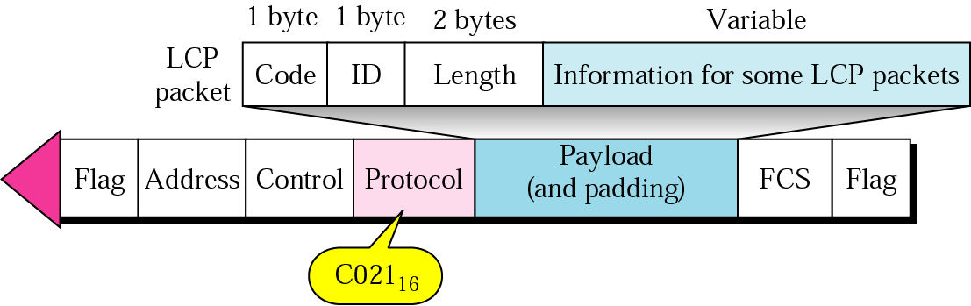
12.4 LCP packet encapsulated in a frame

Slide 8
Table 12.1 LCP packets and their codes
Code | Packet Type | Description
01₁₆ | Configure-request | Contains the list of proposed options and their values
02₁₆ | Configure-ack | Accepts all options proposed
03₁₆ | Configure-nak | Announces that some options are not acceptable
04₁₆ | Configure-reject | Announces that some options are not recognized
05₁₆ | Terminate-request | Requests to shut down the line
06₁₆ | Terminate-ack | Accepts the shut down request
07₁₆ | Code-reject | Announces an unknown code
08₁₆ | Protocol-reject | Announces an unknown protocol
09₁₆ | Echo-request | A type of hello message to check if the other end is alive
0A₁₆ | Echo-reply | The response to the echo-request message
0B₁₆ | Discard-request | A request to discard the packet

Slide 9
Table 12.2 Common options
Option | Default
Maximum receive unit | 1500
Authentication protocol | None
Protocol field compression | Off
Address and control field compression | Off

Slide 10
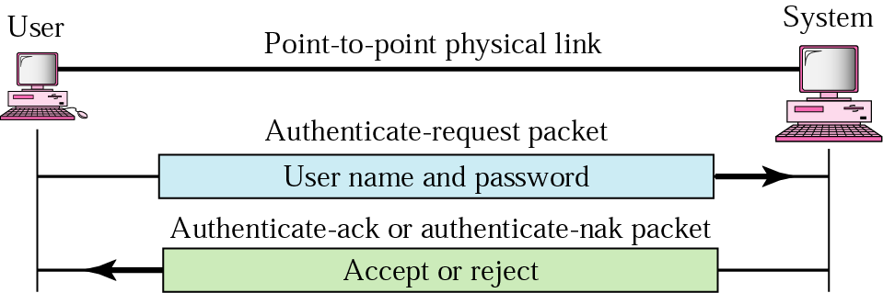
12.5 PAP

Slide 11
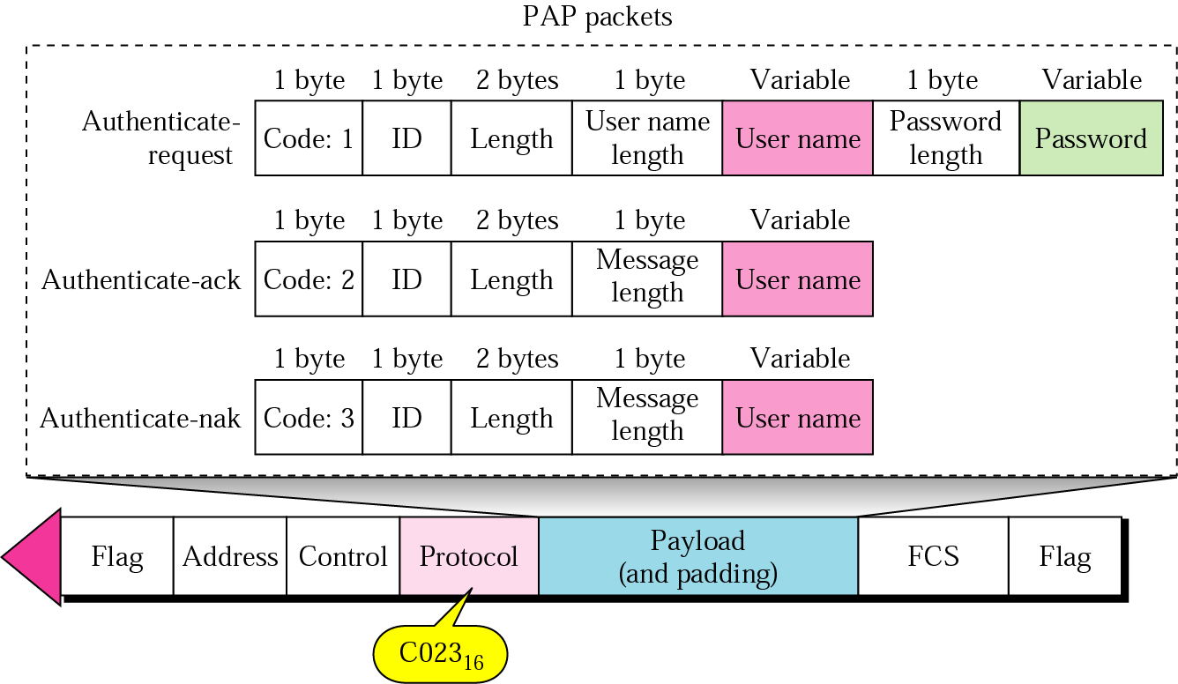
12.6 PAP packets

Slide 12
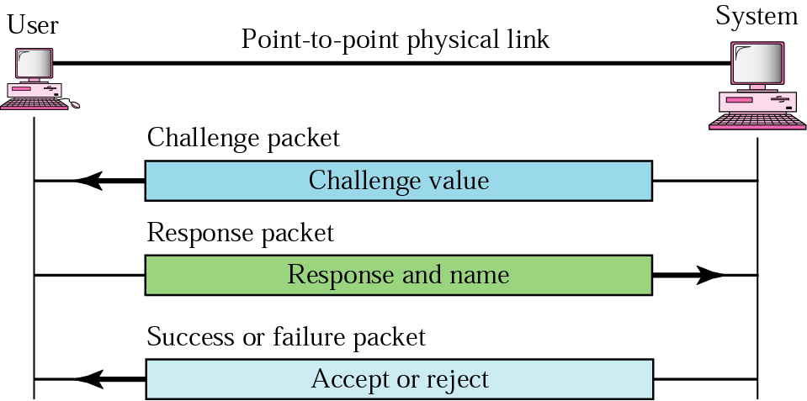
12.7 CHAP

Slide 13
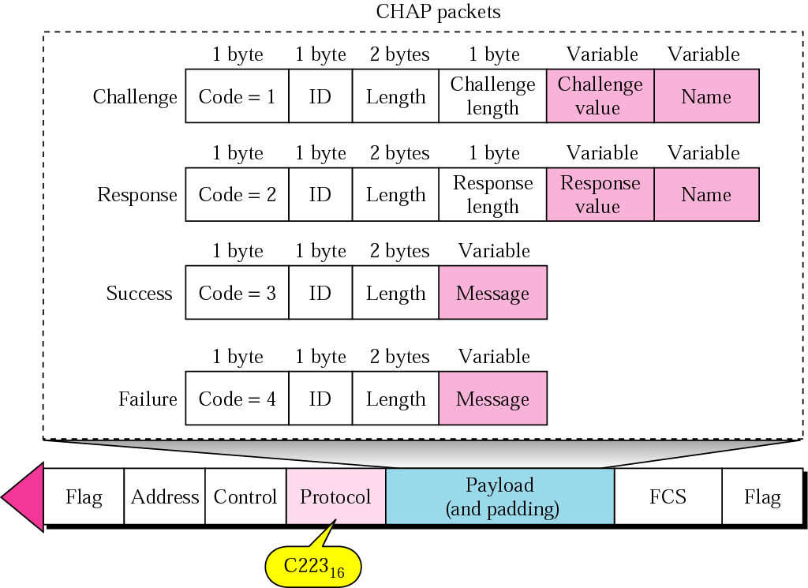
12.8 CHAP packets

Slide 14
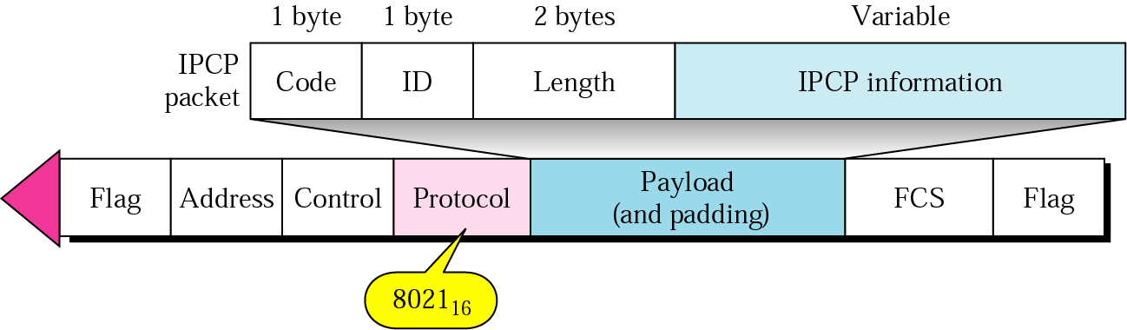
12.9 IPCP packet encapsulated in PPP frame

Slide 15
Table 12.3 Code value for IPCP packets
Code | IPCP Packet
01 | Configure-request
02 | Configure-ack
03 | Configure-nak
04 | Configure-reject
05 | Terminate-request
06 | Terminate-ack
07 | Code-reject

Slide 16
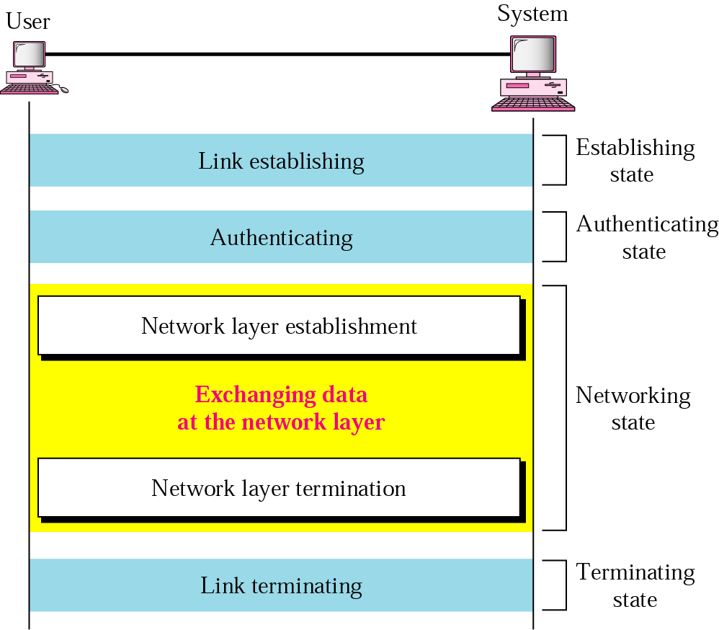
12.10 An example

